Slide 1
NASA Self-Leveling System
EML 4551
Team 516:
Stephen Brown
James Evans
Dalton LeClair
Jake Seaman
Parker Stensrud

Slide 2
Team Introductions
Stephen Brown
Materials Engineer
James Evans
Design Engineer
Dalton LeClair
Test
Engineer
Jake Seaman
Systems Engineer
Parker Stensrud
Controls Engineer

Slide 3
Team Introductions
Stephen Brown
Materials Engineer
James Evans
Design Engineer
Dalton LeClair
Test
Engineer
Jake Seaman
Systems Engineer
Parker Stensrud
Controls Engineer

Slide 4
Sponsor and Advisor
Project Sponsor
Rachel McCauley
NASA Marshall Space Flight Center
Faculty Advisor
Dr. Dorr Campbell
FAMU-FSU College of Engineering
Stephen Brown

Slide 5
Project Scope
Presented by: Stephen Brown

Slide 6
Objective
The objective of the project is to design a self-leveling system for a human lander with the intent of landing on uneven and unstable lunar terrain.
Stephen Brown

Slide 7
Project Description
NASA plans to return to the Moon as part of the Artemis missions in 2024
Planning to land on the lunar south pole in search of water deposits
Expecting uneven and unstable terrain
Stephen Brown

Slide 8
Key Goals
Design a self-leveling system to be used for future moon landings
The ability to land and level on uneven terrain
A design that is reusable in the harsh space environment
Create a functional scaled prototype
Stephen Brown

Slide 9
Assumptions
Prototype tested in Earth's atmosphere under similar terrain constraints
Acceptable range of ground slope maxima and minima
Leveling will commence after contact with the lunar surface
Power sourced from the lander’s main power supply
Stephen Brown

Slide 10
Stakeholders
NASA Marshall Space Flight Center (MSFC) Advanced Concepts Office (ACO)
Commercial Lunar Payload Services (CLPS)
Stephen Brown

Slide 11
Stakeholders
Senior Design Coordinator
Dr. Shayne McConomy
FAMU-FSU College of Engineering
Stephen Brown

Slide 12
Project Background
Presented by: Stephen Brown

Slide 13
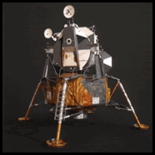
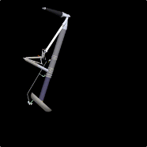
Lunar Lander
Sensors
Payload
Apollo Landing Gear
Stephen Brown

Slide 14
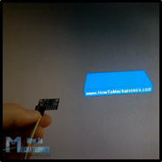
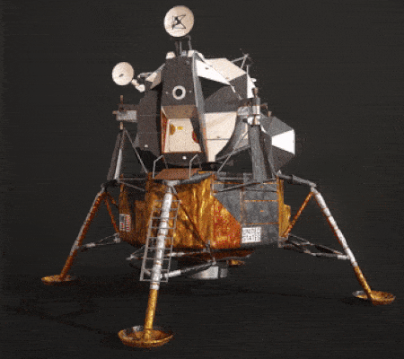
Lunar Lander
Sensors
Payload
Apollo Landing Gear
Stephen Brown

Slide 15
Lunar Lander
Sensors
Payload
Apollo Landing Gear
Stephen Brown

Slide 16
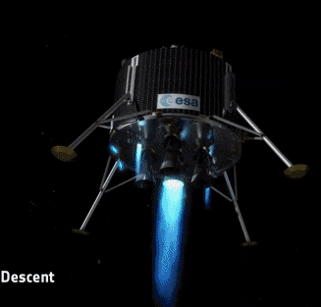
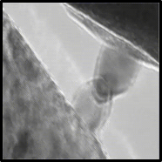
Space Environment
“Sand-Blasting” due to regolith
Cold Welding
Extreme Temperatures
Stephen Brown

Slide 17
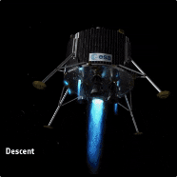
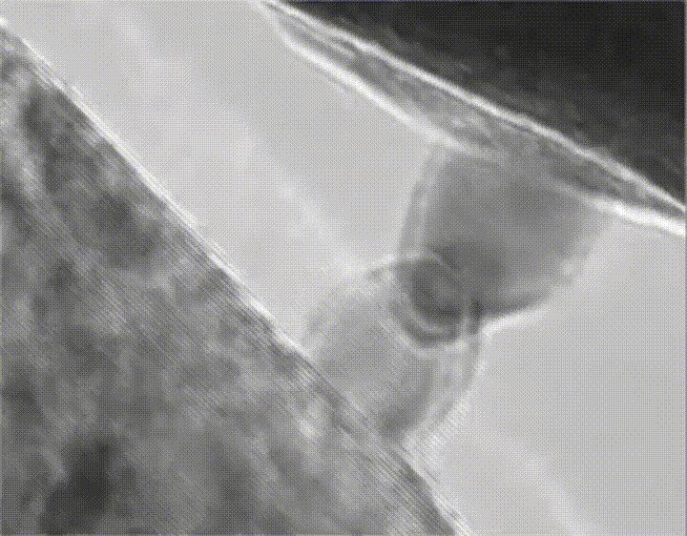
Space Environment
“Sand-Blasting” due to regolith
Cold Welding
Extreme Temperatures
Stephen Brown

Slide 18
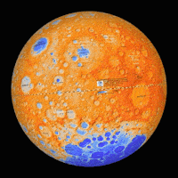
Space Environment
“Sand-Blasting” due to regolith
Cold Welding
Extreme Temperatures
Stephen Brown

Slide 19
Needs and Functions
Presented by: Jake Seaman

Slide 20
Critical Needs
Level environment
Low maintenance
Material considerations
Jake Seaman

Slide 21
Motion
Primary design component
Self-leveling system
Simulation
Prototype
Jake Seaman

Slide 22
Motion
Transform Electricity Into Mechanical Motion
Angle
Transform Electricity Into Mechanical Motion
Translate
Identify Angle Offset
Jake Seaman

Slide 23
Power
Power drawn from existing lander power
Energy efficiency
Low impact to design
Jake Seaman

Slide 24
Power
Translate Power
Receive Power
Jake Seaman

Slide 25
Sense
Level after lunar surface contact
Identify the need to level
Define level
Jake Seaman

Slide 26
Sense
Recognize Signal
Detect Signal
Process Signal
Identify Signal
Distribute Signal
Jake Seaman

Slide 27
Lander
Level lander environment
Stability
Weight impact
Low maintenance
Jake Seaman

Slide 28
Lander
Stabilize
Halt Mechanical Motion
Level
Transform Electricity Into Mechanical Motion
Identify Angle Offset
Jake Seaman

Slide 29
Functional Decomposition Flow Chart
Self-Leveling System
Lander
Motion
Sense
Power
Jake Seaman

Slide 30
Major Takeaways
The astronauts need a level working environment inside the lander
The design will be influenced by:
Environment
Materials
Reusability
Team Assumptions
Jake Seaman

Slide 31
Future Work
Targets & Metrics
Concept Generation
Concept Selection
Testing
Prototyping
Jake Seaman

Slide 32
Future Work
Targets & Metrics
Concept Generation
Concept Selection
Testing
Prototyping
Current Stage
Jake Seaman

Slide 33
Future Work
Spring Semester
Targets & Metrics
Concept Generation
Concept Selection
Testing
Prototyping
Current Stage
Jake Seaman

Slide 34
NASA Self-Leveling System
EML 4551
Team 516:
Stephen Brown
James Evans
Dalton LeClair
Jake Seaman
Parker Stensrud
Questions?

Slide 35
Reference
Williams, M. (2018, August 22). What is Lunar Regolith? Retrieved October 11, 2020, from https://www.universetoday.com/20360/lunar-regolith/
Curiosmos Send an email, Curiosmos, & Email, S. (2020, March 09). Why Artemis? 5 Things You Should Know About NASA's 2024 Manned Moon Mission. Retrieved October 11, 2020, from https://curiosmos.com/why-artemis-5-things-you-should-know-about-nasas-2024-manned-moon-mission/
Potter, S. (2020, April 30). NASA Names Companies to Develop Human Landers for Artemis Missions. Retrieved October 10, 2020, from https://www.nasa.gov/press-release/nasa-names-companies-to-develop-human-landers-for-artemis-moon-missions
Mosher, D. (2018, November 30). NASA's first moon landings in nearly 50 years may happen in 2019. The agency thinks these 9 companies can get it to the lunar surface. Retrieved October 12, 2020, from https://www.businessinsider.com/nasa-moon-landing-mission-private-competition-2018-11
Thread: Cold welding GIF. (n.d.). Retrieved October 13, 2020, from https://www.homemadetools.net/forum/cold-welding-gif-56268
Apollo-Animation [.mpg]. (2020, October 08). NASA.

Slide 36
Self-Leveling System
Lander
Motion
Sense
Power
Angle
Transform Electricity Into Mechanical Motion
Identify Angle Offset
Translate
Transform electricity into mechanical motion
Translate Power
Receive Power
Recognize Signal
Detect Signal
Process Signal
Identify Signal
Distribute Signal
Stabilize
Halt Mechanical Motion
Level
Transform Electricity Into Mechanical Motion
Identify Angle Offset

Slide 37
Customer Needs
Questions | Response | Interpretation
1. What do you like about the current lander leg systems? | We like the stability and weight. | The design needs to keep the stability and weight of previous lander legs in mind.
2. What do you dislike about the current lander leg systems? | It does not self-level. | The design is to have self-leveling capabilities.
3. What part of the landing mechanism is our team responsible for? | We planned on you designing the legs and ground contact points. | The team is to design the legs and contact point with the landing surface.
4. Are we limited to a certain material? | No, however the materials used must have X specific properties. | The team is to select a material that meets specified properties.
5. What is the maximum mass that the legs will be supporting? | 15,000 kg in earth's gravity (weight of the Apollo moon lander) | The legs are to support a maximum weight of 15,000 kg on Earth.
6. What scale are we designing to? | The model should be parametric which allows for variable scale. | The CAD will be done parametrically.

Slide 38
Customer Needs
7. What software should our team simulate in? | Industry friendly that allows for easy sharing. | The team will use the software of their choice.
8. How detailed would you like the simulation to be? Fully/Partially Animated etc. | The function of the self-leveling system must be fully animated but other parts can be partially animated. | The team is responsible for a detailed simulation of the self-leveling system.
9. What lander platform should we be designing for? | The system should be able to be applied onto various lander models. | The self-leveling system needs to be able to be applied to different lander models.
10. Do the legs need to be stored away while not in operation? Do they need to be secured? | No. | The legs can be rigidly attached to the lander.
11. What will the system be powered by? | It will have a common power source with the rest of the lander. | The team is not responsible for designing a power system.

Slide 39
Customer Needs
12. Do we need to be worried about the time it takes for the legs to level? | Yes, it should at maximum take 2 minutes. | The legs are to level the lander within 2 minutes of landing.
13. Do we need to be worried about clearance under the lander? | Yes, there need to be at least 1 meter of clearance. | There is to be a minimum clearance of 1 meter above the landing surface.
14. Does the leveling need to occur upon landing or during approach? | The leveling process will start upon landing. | The self-leveling process is to begin upon landing.

Slide 40
Backup Slides

Slide 41
Market
Primary
Secondary
NASA Marshall Space Flight Center (MSFC) Advanced Concepts Office (ACO)
European Space Agency
SpaceX
Blue Origins
Virgin Galactic
Department of Defense
Stephen Brown

Slide 42
Functional Decomp Backup

Slide 43
Team Introductions
Stephen Brown
***Engineer

Slide 44
Team Introductions
Stephen Brown
***Engineer
James Evans
***Engineer

Slide 45
Team Introductions
Stephen Brown
***Engineer
James Evans
***Engineer
Dalton LeClair
***Engineer

Slide 46
Team Introductions
Stephen Brown
***Engineer
James Evans
***Engineer
Dalton LeClair
***Engineer
Jake Seaman
***Engineer

Slide 47
Functional Decomposition: Cross-Reference Table
Function | Motion | Power | Sense | Lander
Angle | X |  | x
Transform Electricity into Mechanical Motion | X | X |  | X
Identify Angle Offset | X |  | X | X
Translate
Translate Power | X | X
Receive Power |  | X |  | X
Recognize Signal |  |  | X
Identify Signal |  |  | X
Detect Signal |  |  | X
Process Signal |  |  | X
Output Power |  | X
Stabilize | X |  | X | X
Halt Mechanical Motion | X |  |  | X
Level | X |  | X | X

Slide 48
Standard Shapes
Summary Box
Text box 1
Outlined Text Box

Slide 49
Approved Logos

Slide 50
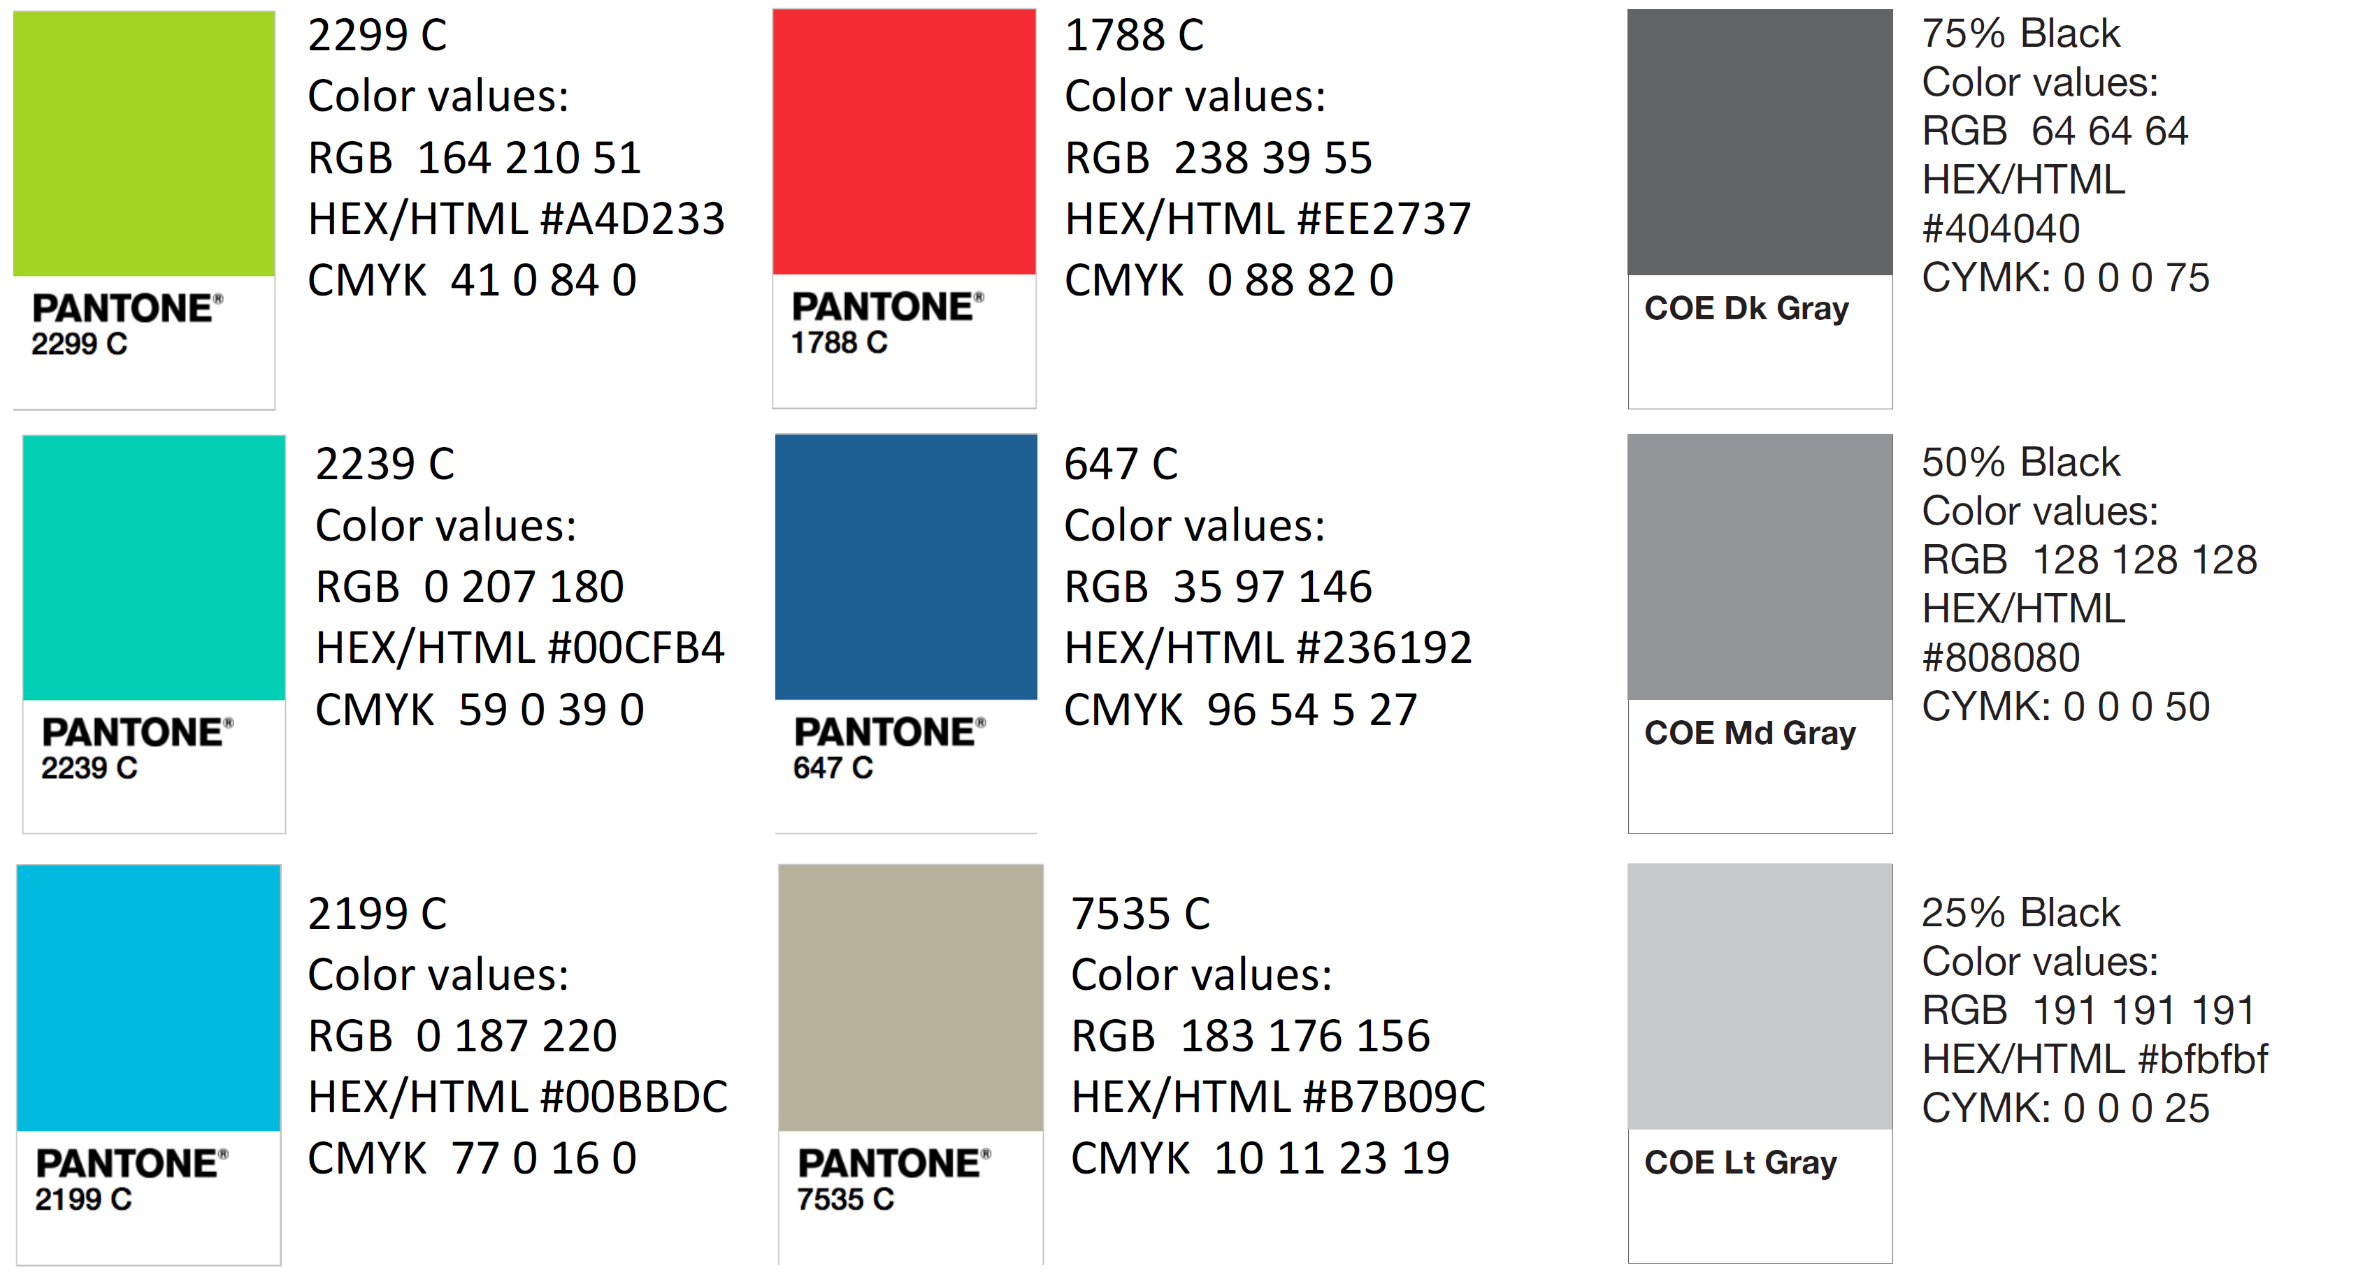
Color Palette

Slide 52
APA Tables
Category 1 | Category 2 | Category 3 | Category 4 | Category 5
Item 1
Item 2
Item 3
Item 4
 | Category 2 |  |  | Category 3
Category 1 | subcategory 1 | subcategory 2 |  | subcategory 1 | subcategory 2
Item 1
Item 2
Item 3
Item 4

